Slide 1

Subscribe to DeepL Pro to edit this document.
Visit www.DeepL.com/pro for more information.

Slide 2
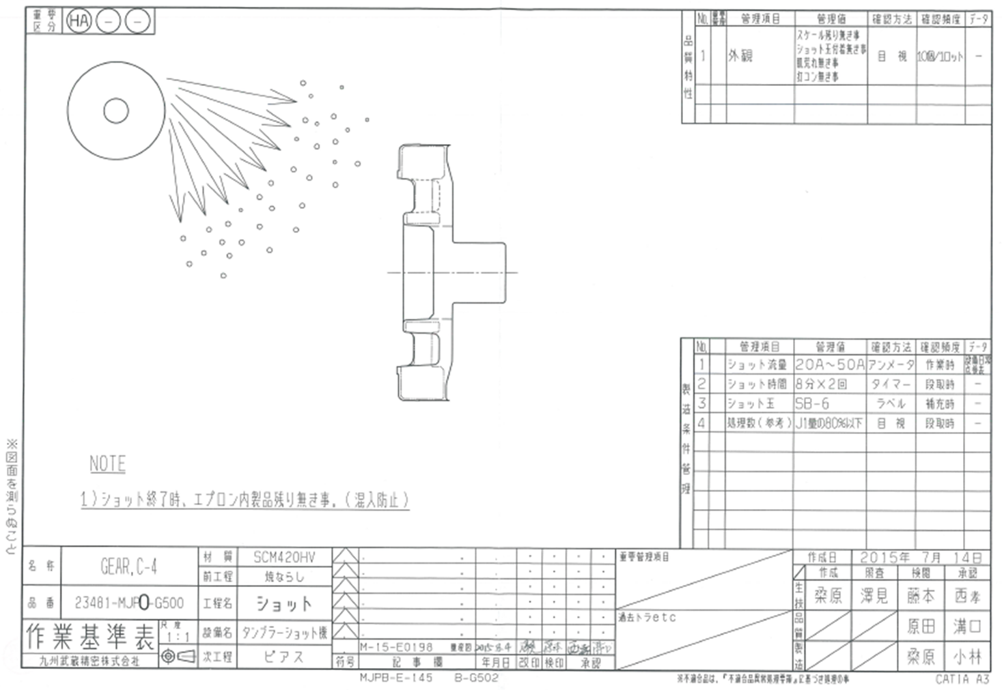
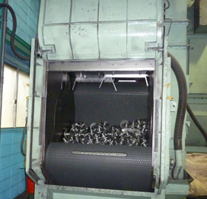
Shot process Work standard table
 | Item | Perspective (Setting)
1 | Installation method illustrated | Tumbler No instructions
2 | Appearance | Scale residue, ball adhesion Management of skin irritation and bruising
3 | Shot flow rate | Ammeter Management
4 | Shot time | Timer management
5 | shot ball (golf) | Material and ball diameter indication
6 | Number of processes (tumblers) | Less than 80% of the J1 quantity
7 | Focused management and past tiger | From the list of priorities and past activities
2
1
3
tumbler shot
4
5
6
7

Slide 3
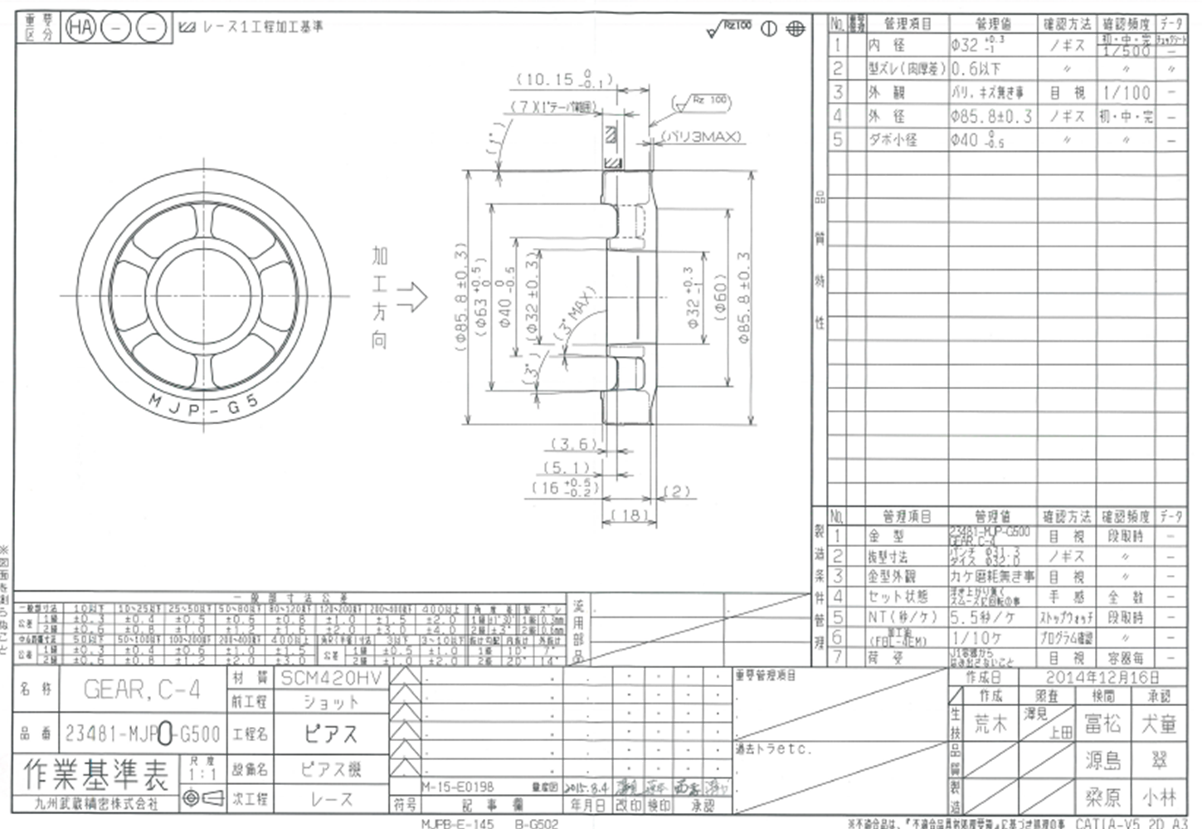
Piercing process work standard chart
 | Item | Perspective (Setting)
1 | Machining direction indication | Prevention of warping and bending
2 | Inner diameter lace processing fee | Allowance 0.35 to 1.0mm
3 | misshapenness | Prevention of black skin residue on cutting parts Wall thickness difference 0.6 or less
4 | Appearance | No burrs or scratches.
5 | outer diameter | Lace processing clamp section
6 | Small diameter of dowel | Forged finishing section, deformation check
7 | Die-cutting dimensions | Inner diameter take-up variation
8 | set state | Floats and rotates smoothly
9 | packing | No protrusion from J1 container
10 | Focused management and past tiger | From the priority and past tiger list
2
3
4
5
6
1
7
8
9
10

Slide 4
Machining Lace
Lace + oil hole
oilcan
brooch
reverse taper

Slide 5
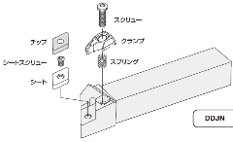
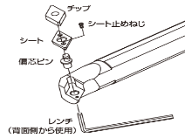
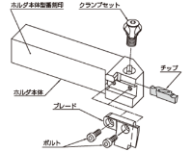
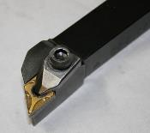
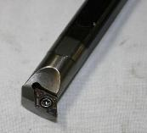
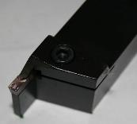
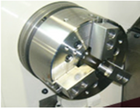
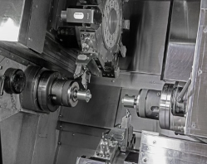
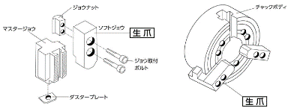
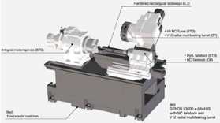
lacework
machining diagram | Processing details
Double dowel GERA
Single dowel GEAR
Holders and tips
zipper
Outer diameter processing holder | Bore processing holder | Grooving holder
zipper
Outer diameter machining
Groove machining
End face machining
End face machining
rotation (usu. around something)
end (e.g. of street, hallway, etc.)
rotation (usu. around something)
end (e.g. of street, hallway, etc.)
work
work
OP-1 Outer diameter clamp
OP-2 Outer diameter clamp
zipper
turret
zipper
Outer diameter machining
End face machining
End face machining
collet
zipper
Seat surface processing
bevelling
rotation (usu. around something)
Internal diameter machining
rotation (usu. around something)
Processing with OP-1...
While rotating the mounted workpiece, feed is given to the turret to perform end-face and inside diameter machining.
The optimum conditions for the number of rotations and feed rate are selected for each part to be machined.
end (e.g. of street, hallway, etc.)
Machining with OP-2: (In the case of double dowels) While rotating the mounted workpiece, feed is given to the turret to groove the end face, fork groove and bore. The optimum conditions for rotation speed and feed rate are selected for each machining area.
end (e.g. of street, hallway, etc.)
OP-1 Outer diameter clamp
OP-2 Internal diameter clamp

Slide 6
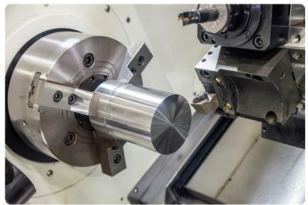
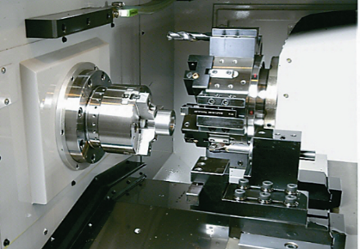
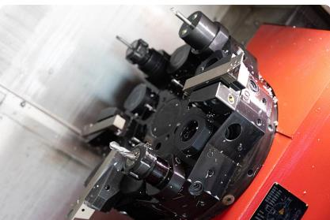
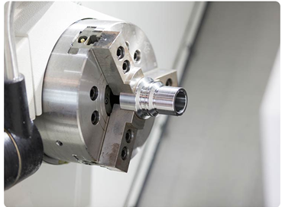
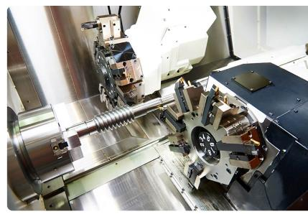
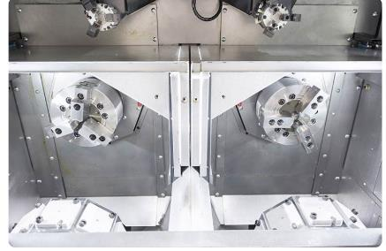
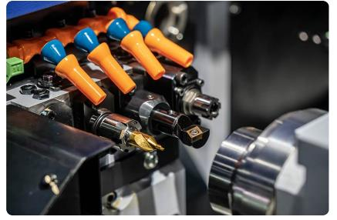

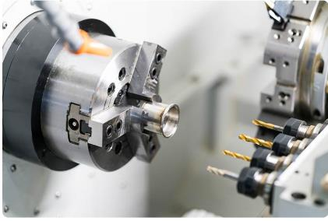
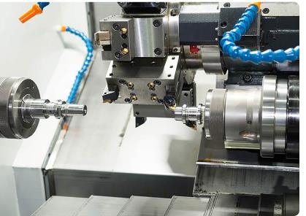
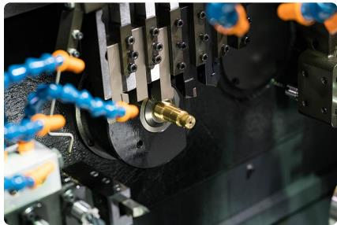
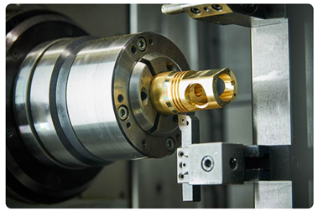
Type of lathe (Reference)
1 turret lathe | Main spindle Single spindle lathe | Turret type turret | 3-jaw interlocking scroll chuck
2-turret lathe | Parallel spindle lathe | Knife blade type tool rest | 4-Jaw Single Action Chuck (Independent Chuck)
Saw blade type lathe | Opposed spindle lathe | Swiss type | collet chuck

Slide 7
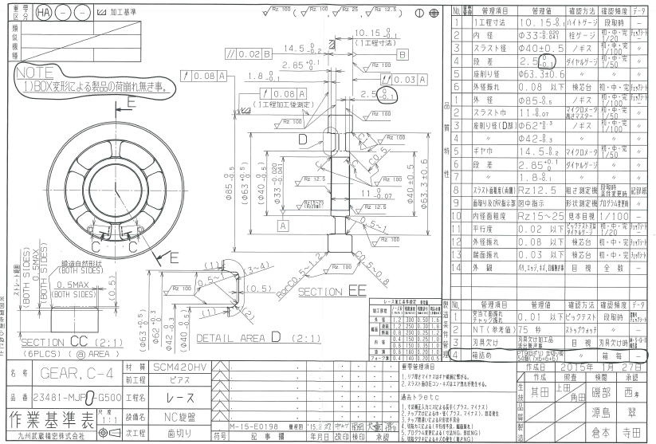
Lace process (flat gear) work standard chart
12
 | Item | Perspective (Setting)
1 | Thrust and clamp criteria for press process instructions | Decided by the forging method of the material Check if it is possible to use it as a top/bottom type or butt face
2 | One process dimension of press process instruction | Machining dimensional instructions in one process from butt reference
3 | Internal diameter honing allowance | Allowance setting 40 to 80μ (Heat treatment strain -20)
4 | Roughness indication for internal diameter honing | Completion 6.3Rz -> Race Instructions Aiming at Rz20 (Improving grindability by honing)
5 | Runout indication of black skin area by internal diameter standard | In the case of the finished dowel position degree of 0.12 instruction → Race 0.08 or less
6 | Outer diameter chamfering One process, two processes | 1 process C0.5～0.8 2 process RorC0.5 to 1.2
7 | Longitudinal indication based on the end face of one process machining | Tolerance -0.2 (as indicated in the completed drawing)
8 | Total runout indication for one process side based on inside diameter | Total runout 0.03 max. Back-end reference plane
9 | Indicate the parallelism of the 2 process machining side | Parallelism 0.02 or less Back-end reference plane
10 | Thrust tolerance | 0/-0.07 Completion drawing instruction
11 | Shape measurement of detail drawing and R indication part | Measurement instructions for all locations
12 | roughness indication | Indicate the roughness of the area to be processed.
13 | Thrust and chuck runout | Manufacturing conditions 0.01 or less
14 | Boxing instructions | Production control (packing format setting)
15 | Important management and past tiger | From the list of priorities and past activities
1
9
7
2
8
5
OP-1
OP-2
3
10
11
4
6
13
14
Priority management items (gear racing)
Key Quality Characteristics | Warranty management items | Item content (final event)
Rib width | Machining dimension setting | Negative rib width leads to gear damage.
Sliding surface roughness | Machining condition management, tool management | Large roughness can lead to abnormal wear, and dents and scratches can lead to air leaks.
Thrust end face | Machining condition management, tool management | Pressure roots and scratches will cause air leakage.
15

